Slide 1
Our First Data Structures:
Arrays and Collections

Slide 2
Array
Can be multi-dimensional
Fixed Size
Datatype is specified
Advantages
Fast execution
Automatic type checking
Can be multi-dimensional
Disadvantages
You must handle expansion or contraction of the data type in your code
Fruit[] fruitArray = new Fruit[6];

Slide 3
. NET Generics
We are taking a small detour here, as we are talking about a .NET specific implementation of ADTs
.NET Generics make it possible to design ADTs that defer the specification of the data type they will hold until the class is declared and instantiated by client code.
Living in System.Collections.Generic library, are these collection classes that can be typed
List<T>
Stack<T>
Queue<T>
…
They combine the advantages of automatic growth and type checking

Slide 4
<T> Type Parameter
<T> represents a variable type
Type can be specified when the reference variable is declared
List<int> myList = new List<int>();
List<Fruit> myFruitList = new List<Fruit>();

Slide 5
Generics
Avoid the need to create many classes that do the “same thing” but use different types
We don’t need
ListInt
ListDouble
ListDecimal
And especially, ListStudents, ListFruit, i.e. you classes
We just have List<T>

Slide 6
Ok, back to ADTs, specifically, a List
Dynamically resize. You can add items, you can remove items anytime.
list.Clear(); will empty the list
IndexOf searches List collections.
Returns the element index of a certain value in the List collection, searches for the first position of the value specified.
When using IndexOf, you must always test for -1 (means none found), or you will get exceptions that you will have to deal with elsewhere
Reverse - reverse all items in the list
Sort
For strings it orders alphabetically.
For numbers it orders from lowest to highest
For objects, your classes must implement an IComparable<T> interface, and then you decide what is small, what is bigger.

Slide 7
List.count and foreach
static void Main()
{
List<int> list = new List<int>();
list.Add(2);
list.Add(3);
list.Add(7);
foreach (int prime in list) // Loop through List with foreach
{
Console.WriteLine(prime); // prime, or whatever name you want
}
for (int i = 0; i < list.Count; i++) // Loop through List with simple for
{
Console.WriteLine(list[i]); // instead of array.Length, use .Count
}
}

Slide 8
Queue and Stack
With a List, you don't need to worry about resizing or capacity limits, and there are numerous List methods for searching, sorting, and modifying the List's data
There is no enforced meaning to the order of items
Now we will look at the Queue and Stack.
They differ from the List class in that there are limitations on how the Queue and Stack data can be accessed.
The order of items is enforced

Slide 9
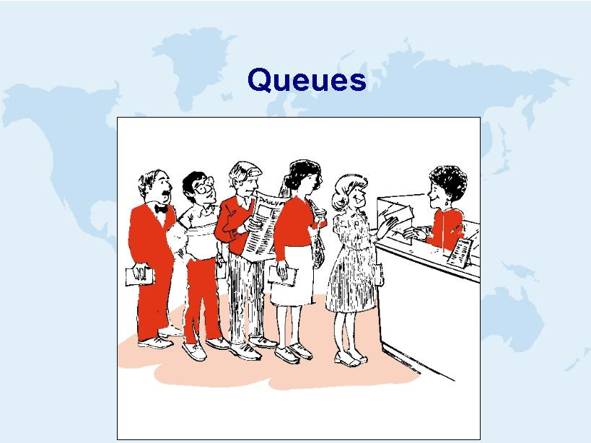
First Come, First Served
(we will dig into these after we do Stacks)

Slide 10
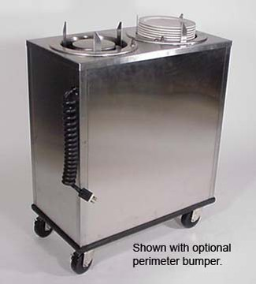
Stacks
First Come, Last Served

Slide 11
Stack<T>
Stack - First Come, Last Served; less common in real life, but often in programing such as for a recursion, call stack or parsing grammars; does not allow random access (no line jumping!)
Class like a dinner plate device in a cafeteria, push the plates down, pop the top one
Objects enter the stack at the top
Objects are removed from the top of the stack
LIFO data structure - Last In First Out

Slide 12
More uses of stack
Used where reversal of data is needed
“Undo”/ “Redo” feature of Word
Finding one’s way through a maze
Reverse Polish Notation
Depth-First Search of a tree structure (ex: BinarySearchTree.Print), later in course
Detecting palindromes (you’ll do this in code)

Slide 13
Stacks
Watch animation: http://www.cs.usfca.edu/~galles/visualization/StackArray.html
See stack program using .NET built in

Slide 14
API for our stack
void Push(int item)
If the stack is not full, add item to the top of the stack, if it is full, throw OverflowException
int Pop()
If the stack is not empty, then the top item is removed & returned, if it is empty, throw IndexOutOfRangeException
int Peek()
If the stack is not empty, then the top item is returned, but the stack is unchanged. If it is empty, then throw IndexOutOfRangeException
bool IsEmpty()
If the stack is empty, then true is returned. Otherwise, returns false.
void Clear()
Empty the stack.

Slide 15
Considerations
How do we store our stack items?
How many can we store?
How do we access the “top” whatever, wherever that is?

Slide 16
Implementation
Declare variables to keep track of
An array of integers to store the contents of the stack (could be a stack of other types if wanted)
An integer to keep track of the index of the ‘top’ of the stack. If there are no items in the stack, we’ll set this to -1.
An integer to keep track how many entries are in the Q

